Slide 1
JAVA PERSISTENCE
WITH
HIBERNATE

Slide 2
Session 1: Understand concepts
Session 2: Working with objects
Session 3: Mapping Concepts And Strategies
Session 4: Optimizing fetching
Session 5: Spring Transaction Management
Session 6: Caching

Slide 3
Session 1: Understand concepts
What is ORM (Object-relational mapping)?
What is JPA (Java Persistence API)?
What is Hibernate?
What is link of JPA and Hibernate?

Slide 4
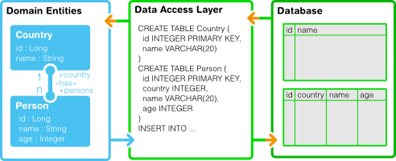
What is ORM?
Object-relational mapping (ORM) is a programming technique in which a metadata descriptor is used to connect object code to a relational database.
Object code is written in object-oriented programming (OOP) languages such as Java or C#.

Slide 5
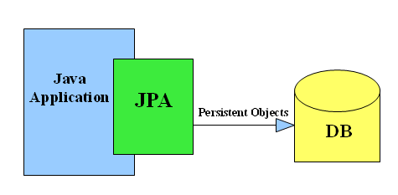
What is JPA (Java Persistence API)?
The Java Persistence API (JPA) is a Java programming language application programming interface specification that describes the management of relational data in applications using Java Platform, Standard Edition and Java Platform, Enterprise Edition.

Slide 6
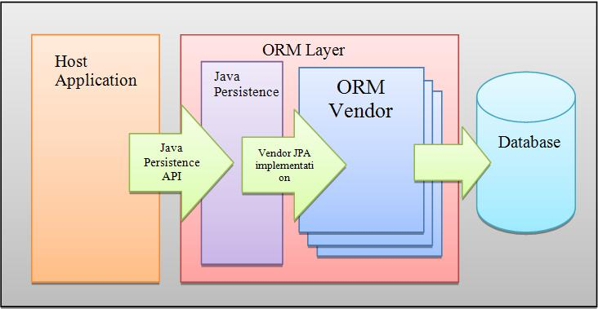
What is Hibernate?
Hibernate is framework that implementation of the Java Persistence API (JPA) specification. As such, it can be easily used in any environment supporting JPA including Java SE applications, Java EE application servers, Enterprise OSGi containers, etc.

Slide 7






What is link of Java Persistence and Hibernate?
ORM
JPA

Slide 8
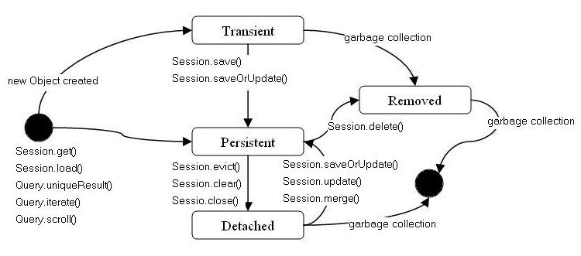
Session 2: Working with objects

Slide 9
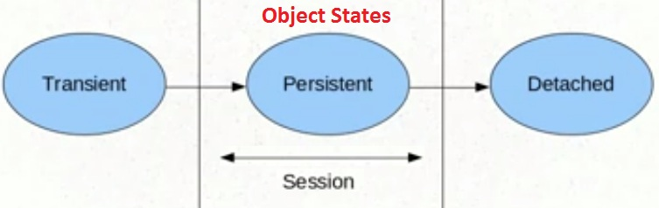
Hibernate lifecycle

Slide 10
Transient
Student student = new Student();
student.setName(“Nguyen Van A”);
Persistent
student = session.get(Student.class,1);
Detach
session.close();

Slide 11
Session 3: Mapping Concepts And Strategies.
Association mappings
Cascade
Fetch plan
Fetch strategies

Slide 12
Association mappings
One to One
One to Many
Many to One
Many to Many
Every relationship has two sides:
The owning side is responsible for propagating the update of the relationship to the database. Usually this is the side with the foreign key.
The inverse side maps to the owning side.

Slide 13


One to One
Class School
{
@OneToOne(mappedBy = “school”)
Principal principal;
}
Class Principal
{
@OneToOne
School school;
}

Slide 14


One to Many/Many to One
class Class
{
@OneToMany(mappedBy = “class")
List<Student> students;
}
Class Student
{
@ManyToOne
Class class;
}

Slide 15

Many To Many
Class Teacher
{
@ManyToMany(targetEntity = Class.class)
@JoinTable(name = “teacher_class",
joinColumns = @JoinColumn(name = “teacher_id"),
inverseJoinColumns = @JoinColumn(name = “class_id"))
List<Class> class;
}
Class Class
{
@ManyToMany(targetEntity=Teacher.class,
mappedBy = “class“)
List<Teacher> teacher;
}

Slide 16
Cascade
JPA
javax.persistence.CascadeType
HIBERNATE
org.hibernate.annotations.CascadeType
CascadeType.ALL
CascadeType.PERSIST
CascadeType.MERGE
CascadeType.DETACH
CascadeType.REFRESH
CascadeType.REMOVE
CascadeType.ALL
CascadeType.PERSIST
CascadeType.MERGE
CascadeType.DETACH
CascadeType.REFRESH
CascadeType.REMOVE
CascadeType.SAVE_UPDATE
CascadeType.DELETE
CascadeType.DELETE_ORPHAN
CascadeType.EVICT
CascadeType.REPLICATE
CascadeType.LOCK

Slide 17
Fetch
Fetch Plan
LAZY
EAGER
@LazyCollection(LazyCollectionOption.TRUE)
@LazyCollection(LazyCollectionOption.FALSE)
Fetch strategy
JOIN
SUBSELECT
SELECT
...

Slide 18

LAZY
Fetch type = LAZY (fetch when needed)
.getStudents()

Slide 19
EAGER
Fetch type = EAGER (fetch immediately)

Slide 20
Fetch strategy for EAGER
@Fetch(FetchMode.SELECT) and @Fetch(FetchMode.JOIN)
Select listStudent from class1
Select listStudent from class2
Select listStudent from class3
....
Select listStudent from class25
@Fetch(FetchMode.SUBSELECT)
Select listStudent from (select class where class in{ 1, 2, 3..25})
@BatchSize(size = 10)
Select listStudent where classId in (? ,? ,? ,? ,? ,? ,? ,? ,? ,?)
Select listStudent where classId in (? ,? ,? ,? ,? ,? ,? ,? ,? ,?)
Select listStudent where classId in (? ,? ,? ,? ,? ,? )
List<Class> class= classService.getAll();
class.size() => 25

Slide 21
Fetch strategy for EAGER
The batch-size fetching strategy is not define how many records inside in the collections are loaded. Instead, it defines how many collections should be loaded.
— Repeat N times until you remember this statement —

Slide 22
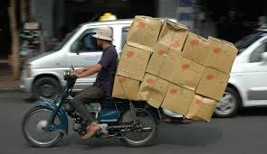

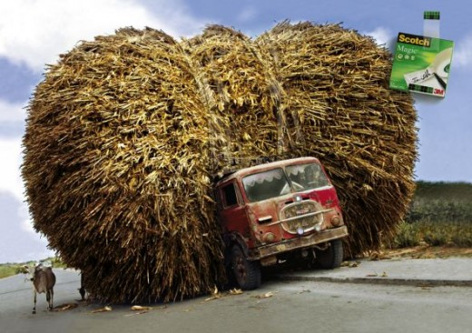

Fetch performance
BATCHSIZE =12
SUBSELECT
SELECT and JOIN

Slide 23
Session 4: Optimizing fetching.
EAGER | LAZY
One to One | One to Many
Many to One | Many to Many

Slide 24
Deal with fetch and session problem
 | Productive(Pros) | Contrary(con)
OpenSessionInViewFilter | -Simple and quickly, just config in web.xml -No need to change Persistence class | -The developer must be very cautious with database transaction errors.
Send model to view instead of Entity class | -No need to change persistence class or web.xml -Transactions are guaranteed | -Must duplicate the data before send it to view.
Manager transaction manually | -No need to change any thing . | -Code more -High risk
Use Lazy fetch plan and custom get method. | -Made the system is under control. | -Write more code -Change persistence class -Good performance
Use Eager fetch plan for all collection | -Very simple and quickly -No change any thing at all. | -Performance can not be guaranteed

Slide 25
Session 5: Spring Transaction Management
About Spring Transaction
Global and local transactions
How it work with Hibernate
Transaction Definition

Slide 26
About Spring Transactions
Unlike EJB CMT, which is tied to JTA, the Spring Framework's declarative transaction management works in any environment. It can work with JDBC, JDO, Hibernate or other transactions under the covers, with configuration changes only.
The Spring Framework enables declarative transaction management to be applied to any class, not merely special classes such as EJBs.
The Spring Framework offers declarative rollback rules: this is a feature with no EJB equivalent. Both programmatic and declarative support for rollback rules is provided.
The Spring Framework gives you an opportunity to customize transactional behavior, using AOP. For example, if you want to insert custom behavior in the case of transaction rollback, you can. You can also add arbitrary advice, along with the transactional advice. With EJB CMT, you have no way to influence the container's transaction management other than setRollbackOnly().

Slide 27
Global and local transactions
Local Transactions - A local transaction is internal to a single resource.
Global Transactions (XA)-A global transaction is created by an external transaction manager (JTA) and is used to scope work on multiple resources.

Slide 28



Transaction difinition
Read Only (use for get function)
Propagation(default= REQUIRED)
Isolation
Better set transactions annotation on Service class

Slide 29


Use Spring Transactions with Hibernate
Spring configuration
Use annotation in method or class

Slide 30
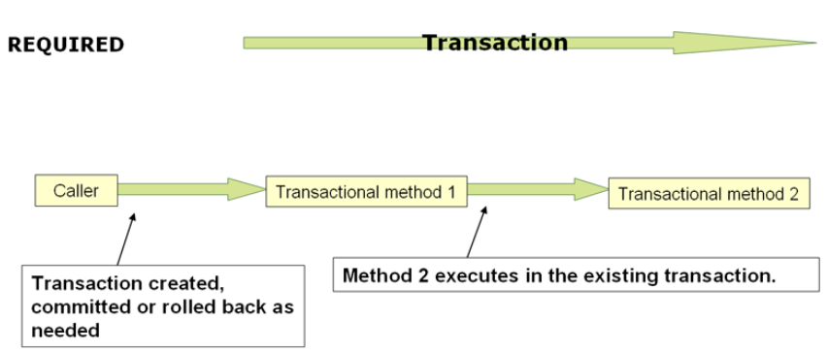
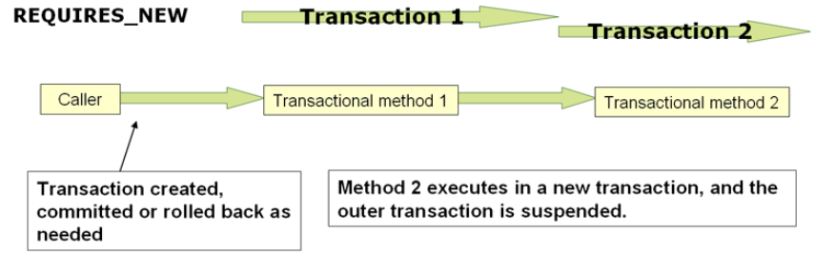
Transaction difinition

Slide 31
Session 6: Caching
Cache level
Concurrency strategies
Cache provider
Configuration EHCache

Slide 32
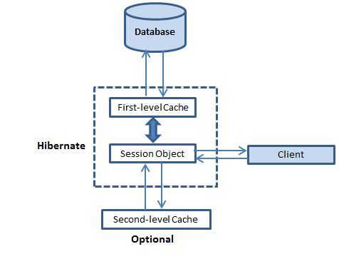
Hibernate cache
First level cache:
-Session cache
-All request must pass.
-Close the session, all object being cache are lost .
-Working with Session object
Second level cache:
-Optional cache
-Caching objects across sessions.
-Third-party cache.
-Working with Session factoroy object

Slide 33
Concurrency strategies:
ReadOnly Cache can do only reads and inserts , cannot perform updates/deletes. Fastest performing.
Nonstrict Read Write Cache doesn’t employ any locks, ever, so there’s always a chance of dirty reads. However, it ALWAYS evicts the entry from the cache so that any subsequent sesssions always refer to the DB.
Read Write Cache employs locks but in an asynchronous manner, first the insert/update/delete occurs w/in the tx. When the cache entry is softlocked and other sessions have to refer to the database. Once the tx. is completed, the lock is released and the cache is updated.(outside the transaction). In some cases, repeatable reads might be compromised.
Transactional Cache obviously update the database and the cache within the same transaction, so its always in a consistent state with respect to the database.
Entity type that are mostly updated and have got concurrent read and updates, read-write caching strategy may not be very useful as most of the reads will be deflected to database

Slide 34
Nonstrict Read Write Cache
Entity t1
Database
Cache L2
Select
Update cache
Entity t1
Entity t2
Entity t1
Entity t2
Update t2 in DB
Update entity t2

Slide 35

Read Write Cache
Entity t2
Database
Cache L2
Select
Update cache
Entity t1
Entity t2
Entity t1
Entity t2
Update t2 in DB
Update entity t2

Slide 36
Cache provider
Cache Name | Description
EHCache | It can cache in memory or on disk and clustered caching and it supports the optional Hibernate query result cache.
OSCache | Supports caching to memory and disk in a single JVM, with a rich set of expiration policies and query cache support.
warmCache | A cluster cache based on JGroups. It uses clustered invalidation but doesn't support the Hibernate query cache
JBoss Cache | A fully transactional replicated clustered cache also based on the JGroups multicast library. It supports replication or invalidation, synchronous or asynchronous communication, and optimistic and pessimistic locking. The Hibernate query cache is supported

Slide 37
Cache provider concurrency strategy compatibility
Strategy/Provider | Read-only | Nonstrict read-write | Read-write | Transactional
EHCache | X | X | X
OSCache | X | X | X
SwarmCache | X | X
JBoss Cache | X |  |  | X

Slide 38
Cache provider concurrency strategy compatibility
Strategy/Provider | Read-only | Nonstrict read-write | Read-write | Transactional
EHCache | X | X | X
OSCache | X | X | X
SwarmCache | X | X
JBoss Cache | X |  |  | X

Slide 39




Implement EHCache in 4 steps
pom.xml
1
hibernate-context.xml
2
3
myehcache.xml
4
Entity Class

Slide 40

References
Java persistence with hibernate 2nd edition book
Concept:
http://www.javaworld.com/article/2077817/java-se/understanding-jpa-part-1-the-object-oriented-paradigm-of-data-persistence.html
http://www.dineshonjava.com/p/transient-persistent-and-detached.html#.U8JChrH7HIU
Cascade:
http://examples.javacodegeeks.com/enterprise-java/hibernate/hibernate-cascade-example/
Fetch:
http://www.mkyong.com/hibernate/hibernate-fetching-strategies-examples/
http://uaihebert.com/four-solutions-to-the-lazyinitializationexception/
Transactions:
http://www.tutorialspoint.com/spring/spring_transaction_management.htm
http://docs.spring.io/spring/docs/3.0.0.M3/reference/html/ch11s05.html
http://docs.spring.io/spring/docs/3.0.x/javadoc-api/org/springframework/transaction/TransactionDefinition.html
Cache:
http://www.tutorialspoint.com/hibernate/hibernate_caching.htm
http://anirbanchowdhury.wordpress.com/2012/07/23/hibernate-second-level-cache-ehcache/
http://www.journaldev.com/2980/hibernate-ehcache-second-level-caching-example-tutorial

Slide 41
Thank you for listening!
Q & A

